Slide 1

Objectives
In this session, you will learn to:
    Implement state management

Slide 2
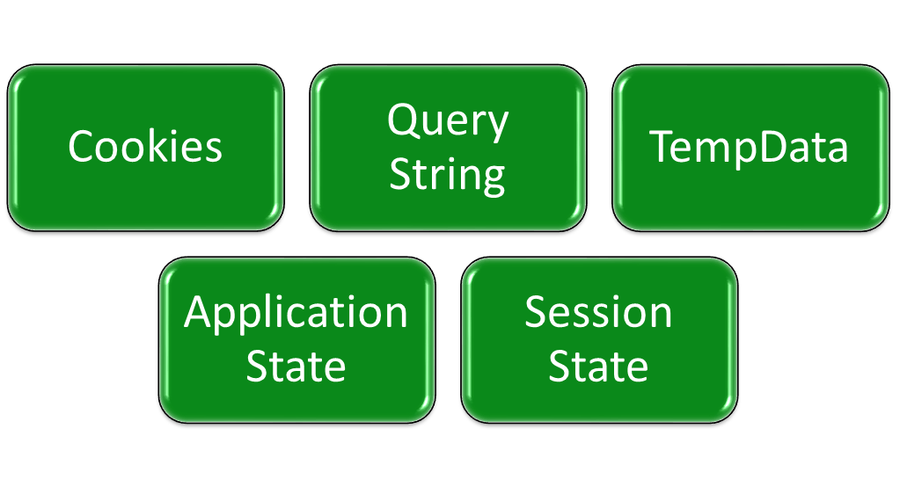
Implementing State Management
While developing a Web application, you may want to implement functionality that requires information to be retained across multiple requests to the server.
This functionality can be implemented by using state management.
Some options available to implement state management are:

Slide 3





Cookies
Are small pieces of information.
Are stored on the client’s computer.
Cookies
Offer a personalized experience to the user.
Can be temporary or persistent.

Slide 4
Cookies (Contd.)
Temporary cookie:
    Exists in the memory space of a browser.
    Is lost if a user closes the browser or logs out.
    Is also known as session cookies.
    Is useful for storing information required for only for a short time.
    Is useful for storing information that should not be written to the disk on a client computer.

Slide 5
Cookies (Contd.)
Persistent cookie:
    Is saved as a text file in the file system of the client computer.
    Is used when you want to store information for a longer time period.
    Can be used to store customized user settings for a website.
    Enables you to set the expiration date of the cookie.
    Is maintained as a temporary cookie, if you do not set its expiration date.
Examples:
    The following code snippet creates persistent cookie:
Response.Cookies ["userName"].Value = "Peter";
Response.Cookies ["userName"].Expires = DateTime.Now.AddDays(2);
Response.Cookies ["lastVisited"].Value =
DateTime.Now.ToString();
Response.Cookies ["lastVisited"].Expires =
DateTime.Now.AddDays(2);

Slide 6
Cookies (Contd.)
    The following code snippet stores multiple values in a single cookie:
Response.Cookies["userInfo"]["userName"] = "Peter";
Response.Cookies["userInfo"]["lastVisited"] =
DateTime.Now.ToString();
Response.Cookies["userInfo"].Expires =
DateTime.Now.AddDays(2);
    The following code snippet reads a cookie that stores a single value:
if (Request.Cookies["userName"]!= null)
{
string Name = Request.Cookies["userName"].Value;
}

Slide 7
Cookies (Contd.)
    The following code snippet reads a cookie that stores multiple values:
if (Request.Cookies["userInfo"] != null)
{
string Name = Request.Cookies["userInfo"]["userName"];
string VisitedOn = Request.Cookies["userInfo"]["lastVisited"];
}

Slide 8
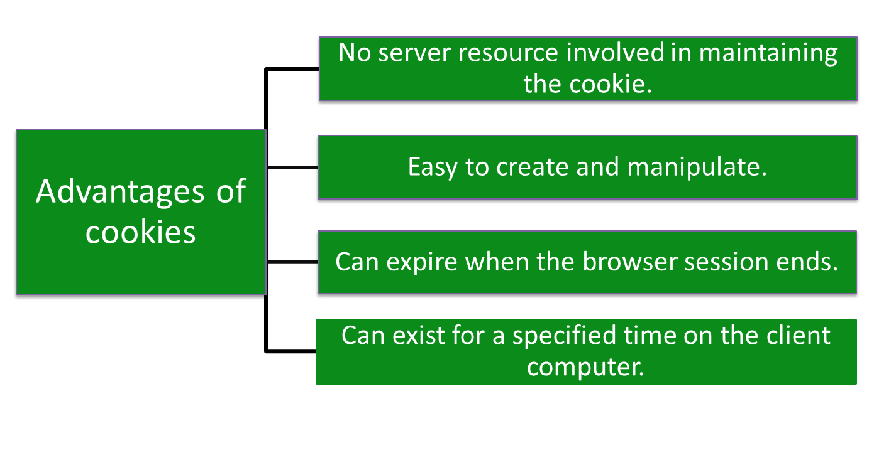
Cookies (Contd.)

Slide 9
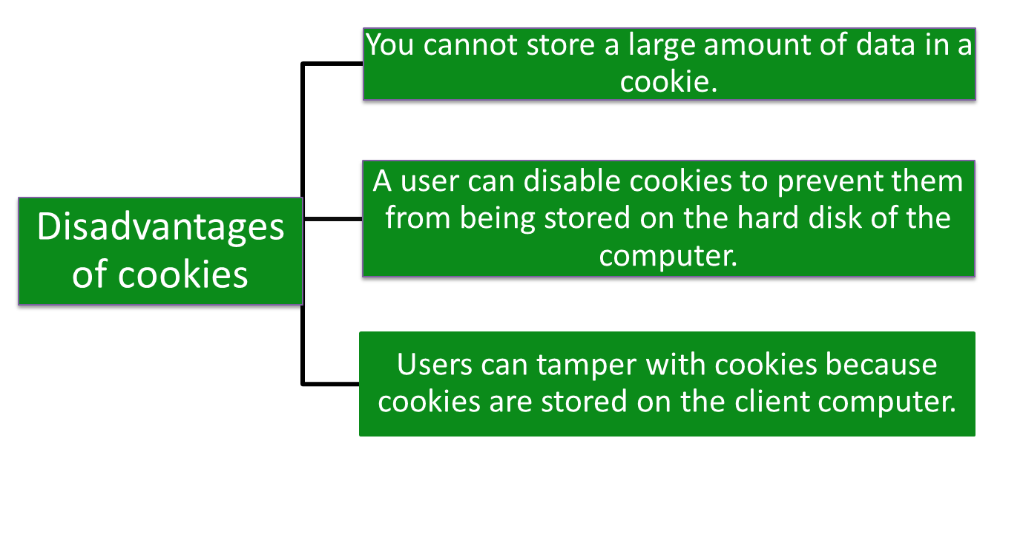
Cookies (Contd.)

Slide 10
Query String
Query string:
    Provides a simple way to pass information from one page to another.
    Is the part of a URL that appears after the Question mark (?) character, as shown in the following URL:
http://www.Newbay.com/search?Category=Electronics
    Allows you to pass data from one page to another page by using the Response.Redirect method, as shown in the following code snippet:
    Response.Redirect(Url.Action("Contact", "Home") + "?Category=Electronics");
Enables you to retrieve the passed information within an action
method, as shown in the following code snippet:
String cat = Request.QueryString["Category"];

Slide 11
Query String (Contd.)
    Enables you to accept the passed information as a parameter in an action method, as shown in the following code snippet:
public ActionResult About(string Category)
{
String cat = Category;
...
return View();
}
    Allows to pass multiple values from one page to another, as shown in the following code snippet:
Response.Redirect(Url.Action("Contact", "Home") +
"?Category=Electronics&Description=Affordable");

Slide 12






Query String (Contd.)
Requires no server resource.
Advantages of query string
Supported by all browsers.
Displays the information directly to the users.
Disadvantages of query string
Some browsers impose a limit of 2083 characters on the URL length.

Slide 13
TempData
TempData:
    Is a dictionary for storing temporary data in the form of key-value pairs.
    Can be used to store values between one request and another.
    Allows values to be added by adding them to the TempData collection.
    Allows preserving values for a single request only.
    Will be available during the current and subsequent requests only, or until the item is removed explicitly.
Example:
public class HomeController : Controller{
public ActionResult Index(){
TempData["text"] = "Hello";
return RedirectToAction("About");
}
public ActionResult About(){
return View();
}}

Slide 14






TempData (Contd.)
Used to pass an error message to an error page easily.
Advantages of TempData
Used to pass the data from the current request to the subsequent request in case of redirection.
It lives only until the time the target view is fully loaded.
Disadvantages of TempData
It can be used to store only one time messages, such as error messages and validation messages.

Slide 15



Application State
Application State:
    Provides a means of storing application-specific information.
    Allows the information to be stored as key-value pairs.
    Is created the first time a user accesses any URL resource in an application.
    Enables the stored information to be shared among all the pages and user sessions of the Web application by using the HttpApplicationState class.
    Is generally initialized and manipulated on the occurrence of certain application events, such as:
Application.Start
Application.End
Application.Error

Slide 16
Application State (Contd.)
You can add application-specific information to the application state by creating variables and objects and adding them to the application state.
Variables and objects added to the application state are global to an ASP.NET application.
The code for initializing application variables and objects is usually written within the Application_Start() function in the Global.asax file.
Example:
HttpContext.Application ["MyVariable"] = "Hello";
To read the value stored in the application state, you can use the key that was used to store the value, as shown in the following code snippet:
string val = (string)HttpContext.Application
["MyVariable"];

Slide 17
Application State (Contd.)
To remove the application variable from the application state, you can use the Remove() method, as shown in the following code snippet:
HttpContext.Application.Remove("MyVariable");
To remove all the application state variables and objects, you can use the RemoveAll() method, as shown in the following code snippet:
HttpContext.Application.RemoveAll();

Slide 18



Application State (Contd.)
Easy to use and consistent with other .NET Framework.
Advantages of application state
Involves maintaining only a single copy of the information.

Slide 19



Application State (Contd.)
The stored data is lost when the Web server containing the application state fails due to server crash, upgrade, or shutdown.
Disadvantages of application state
The application state requires server memory and can affect the performance of the server and the scalability of the Web application, if it occupies excess memory space.

Slide 20


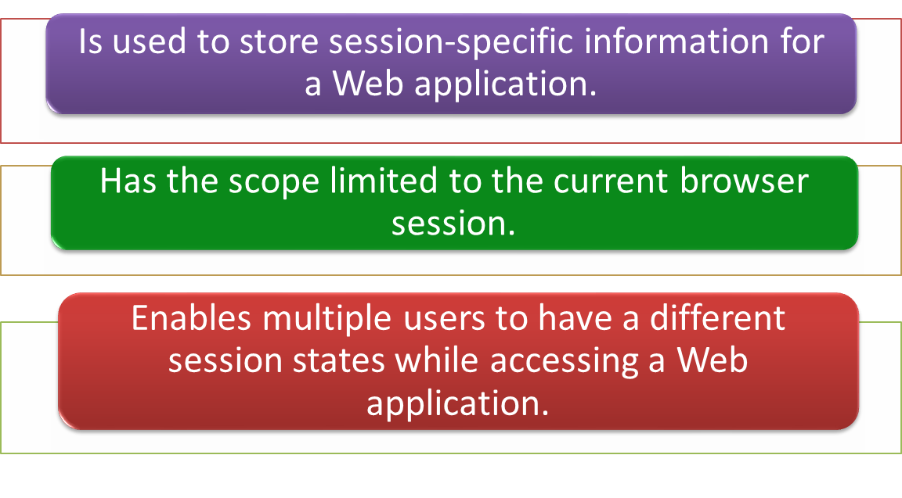
Session State
Session state:

Slide 21
Session State (Contd.)
The session state has a built-in support in ASP.NET.
The built-in session state feature automatically performs the following actions:
    Identify and classify requests coming from a browser into a logical session on the server.
    Store session-specific data on the server.
    Raise session lifetime-related events, such as Session.Start and Session.End, which can be handled in the Global.asax file.
    Automatically release session data if a browser does not access an application within a specified timeout period.

Slide 22
Session State (Contd.)
Each active ASP.NET session is identified and tracked by a unique session ID string.
The session ID strings are communicated across client/server requests by using:
    Either an HTTP cookie or
    A modified URL containing the embedded session ID string
The SessionStateModule class is responsible for generating or obtaining session ID strings.
Similar to the application state, you can store objects and variables in the session state.
By default, a session variable is active for 20 minutes without any user interaction.
In an ASP.NET Web application, the objects stored in the session
state are stored on the server.

Slide 23
Session State (Contd.)
The method of adding and retrieving items from the session state is the same as that of adding and retrieving items from the application state.
Examples:
    The following code snippet adds an item in session state:
    Session["MyVariable"]="HELLO";
    The following code snippets retrieves an item from session state:
string val = (string) Session["MyVariable"];

Slide 24
Session State (Contd.)
Session state is global to the entire application for the current user.
Session state is not lost if the user revisits a Web page or visits a different page by using the same browser window.
However, session state can be lost in the following ways:
    When the user closes and restarts the browser.
    When the user accesses the same Web page through a different browser window.
    When the session times out because of inactivity.
    When the Session.Abandon() method is called within the Web page code.
  You can remove an object or a variable added to the session state by using the following methods:
    The Remove() method
    The RemoveAll() method

Slide 25
Session State (Contd.)
Session state is generally initialized and manipulated on the occurrence of certain events, such as:
    Session.Start
    Session.End
  Session state can be configured through the Web.config file for the application.
  Example:
      <?xml version="1.0" encoding="utf-8" ?>
      <configuration>
      <system.web>
      <sessionState
      cookieless="UseCookies" cookieName="ASP.NET_SessionID"
      timeout="20"
      mode="InProc" />
      </system.web>
      </configuration>

Slide 26





Session State (Contd.)
Ensures the fast accessibility of data.
Advantages of session state
Ensures platform scalability as it can work in a multiprocess configuration.
Disadvantages of session state
It is not advisable to use session state when you are working with a large volume of data.
It affects the performance of memory, because the session state variable stays in memory until you destroy the state.

Slide 27
Just a Minute
Which one of the following options is used to implement client-side state management?
    Cookies
    Application state
    Session state

Slide 28
Just a Minute (Contd.)
Solution:
    Cookies

Slide 29
Demo: Implementing State Management (Contd.)
Solution:
    To implement the preceding functionality, you need to perform the following tasks:
      Modify the MovieController controller.
      Create the Login/Logout links.
      Modify the HomeController controller.
      Create a Login view.
      Execute the application and verify the output.

Slide 30
Summary
In this session, you learned that:
    Some options available to implement state management are:
      Cookies
      Query String
      TempData
      Application state
      Session state
    Cookies are small pieces of information that are stored on the client’s computer.
    Cookies can be either temporary or persistent.
    A query string provides a simple way to pass information from one page to another.
    TempData is a dictionary for storing temporary data in the form of key-value pairs.

Slide 31
Summary (Contd.)
    Application state is created the first time a user accesses any URL resource in an application.
    Session state is structured as a key-value pair for storing session-specific information that needs to be maintained between server round trips and requests for pages.

